Slide 1
Machine Learning for Tabular Data
Fundamentals of Artificial Intelligence

Slide 2
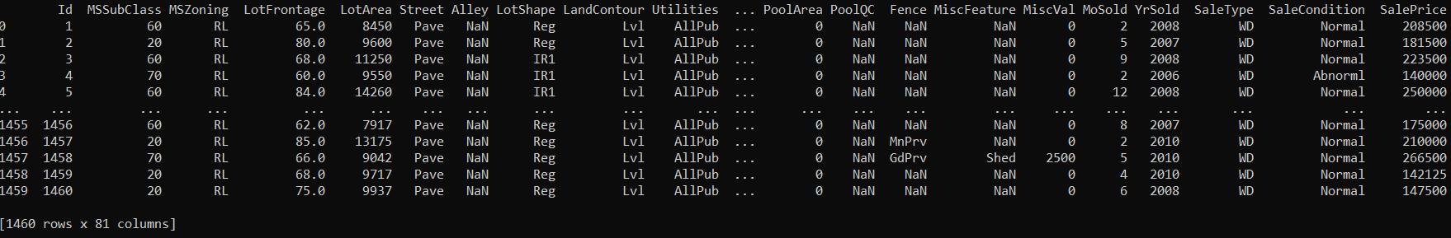

Slide 3

Algorithmic Families of Supervised Learning
parametric models
nearest neighbors (local methods, instance-based learning):
non-parametric models
decision trees:
rule learning
linear regression
Day
neural networks: many linear models, non-linear by means of activation functions
Weekday
Weekend
3
Promo
No
Yes
demand prediction
5
8
often used in ensemble methods
bagging: random forests
boosting: gradient boosting
kernel/support-vector machines: linear model (maximum-margin hyperplane) with kernel trick

Slide 4

Under- and Over-Fitting
example: polynomial fit
need to predict new samples (not in training data set): interpolation
degree of fitted polynomial

Slide 5


Bias, Variance, Irreducible Error
think of fitting ML algorithms as repeatable processes with different data sets
irreducible error (aka Bayes error):
inherent randomness (target generated from random variable)
limiting accuracy of ideal model
bias
due to too simplistic model (same for all training data sets)
“underfitting”
variance
due to sensitivity to specifics (noise) of different training data sets
“overfitting”

Slide 6

Bias-Variance Tradeoff
models of higher complexity have lower bias but higher variance
(given the same number of training examples)
generalization error follows U-shaped curve: overfitting once model complexity (number of parameters) passes certain threshold
overfitting: variance term dominating test error
→ increasing model complexity increases test error
but beware: training error keeps decreasing with more complex model …

Slide 7
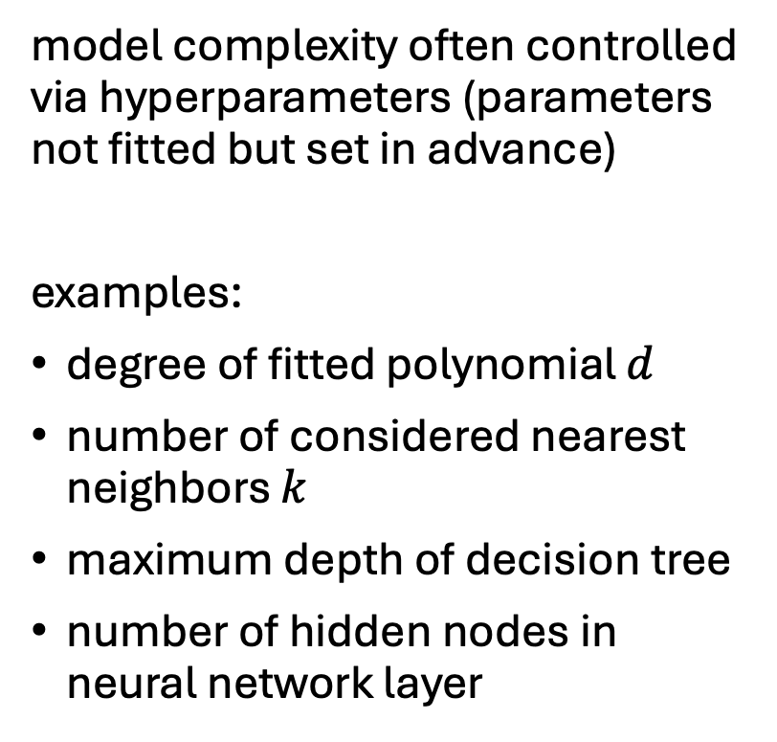
Hyperparameters
model complexity often controlled via hyperparameters (parameters not fitted but set in advance)
examples:
degree of fitted polynomial $d$
number of considered nearest neighbors $k$
maximum depth of decision tree
number of hidden nodes in neural network layer
hyperparameter tuning

Slide 8
Generalization
core of ML: empirical risk minimization (training error) as proxy for minimizing unknown population risk (test error)
generalization gap: difference between test and training error
curse of dimensionality: typically, many features (dimensions)
→ lots of data needed to densely sample volume

Slide 9
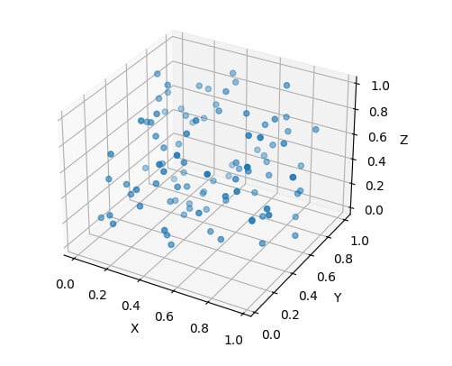
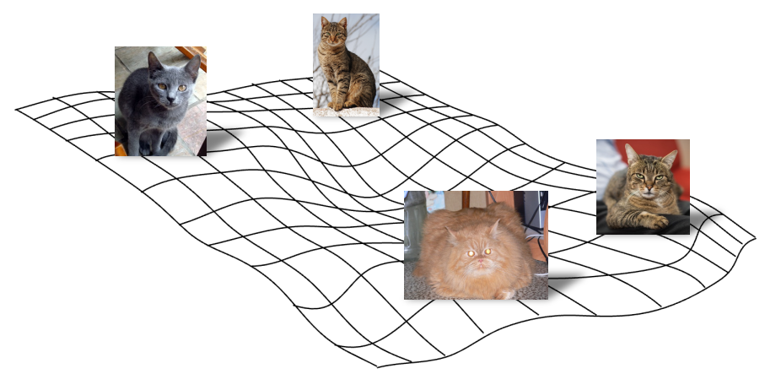
Manifold Hypothesis
luckily, reality is friendly: most high-dimensional data sets reside on lower-dimensional manifolds → enabling effectiveness of ML

Slide 10
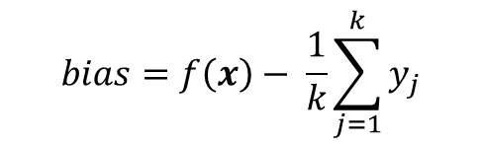
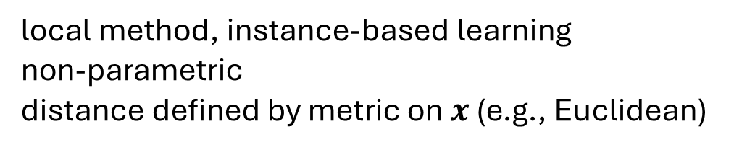
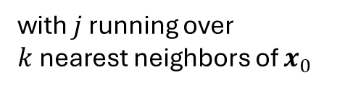

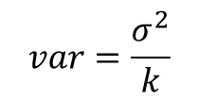
k-Nearest Neighbors (kNN)
local method, instance-based learning
non-parametric
distance defined by metric on $x$ (e.g., Euclidean)
regression:
$$\hat{f}\left(x_{0}\right)=\frac{1}{k}\sum_{j=1}^{k}{y_{j}}$$
with $j$ running over $k$nearest neighbors of $x_{0}$
low k: low bias but high variance
high k: low variance but high bias
$$bias=f\left(x\right)− \frac{1}{k}\sum_{j=1}^{k}{y_{j}}$$
$$var=\frac{σ^{2}}{k}$$

Slide 11
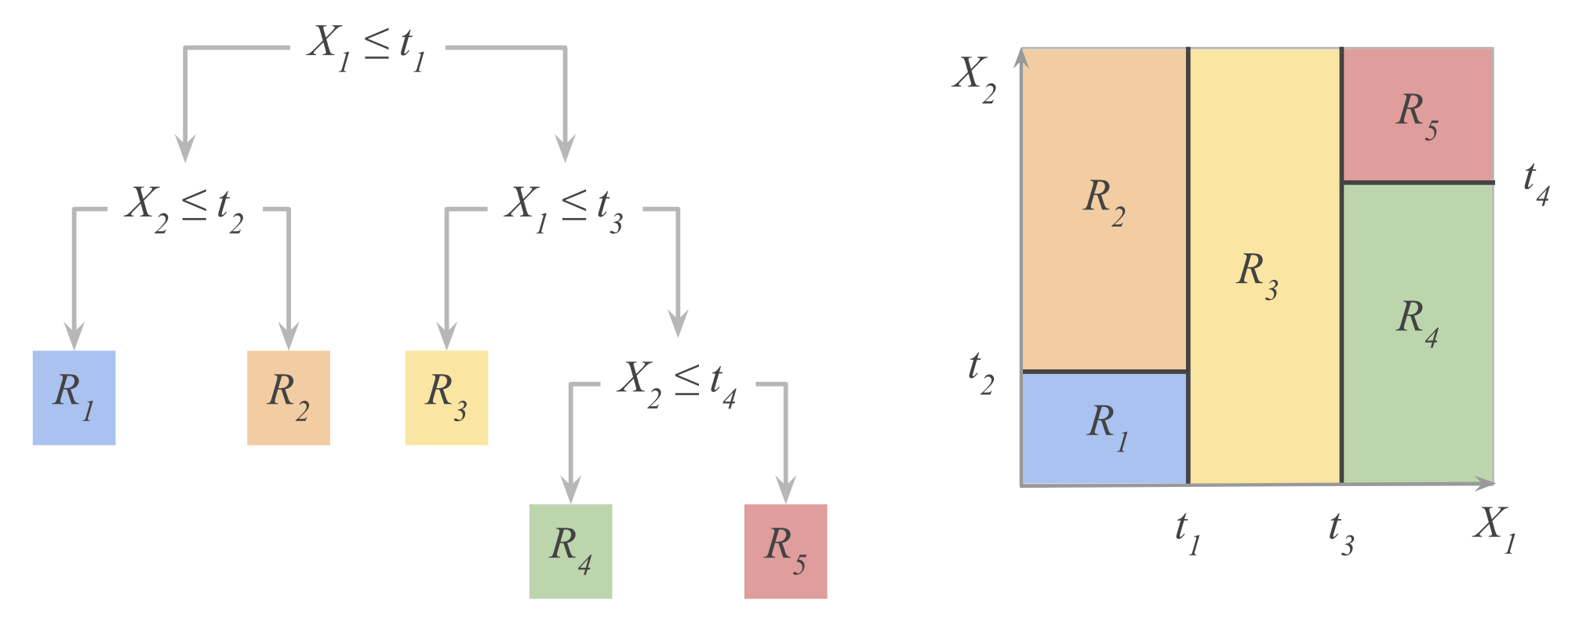
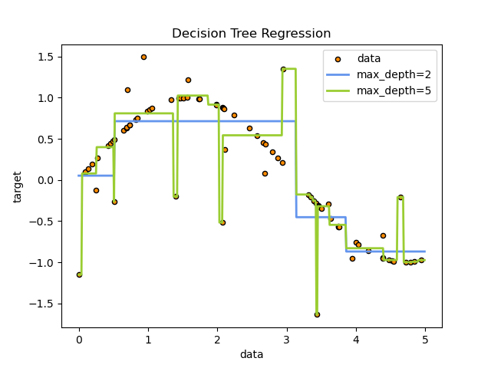
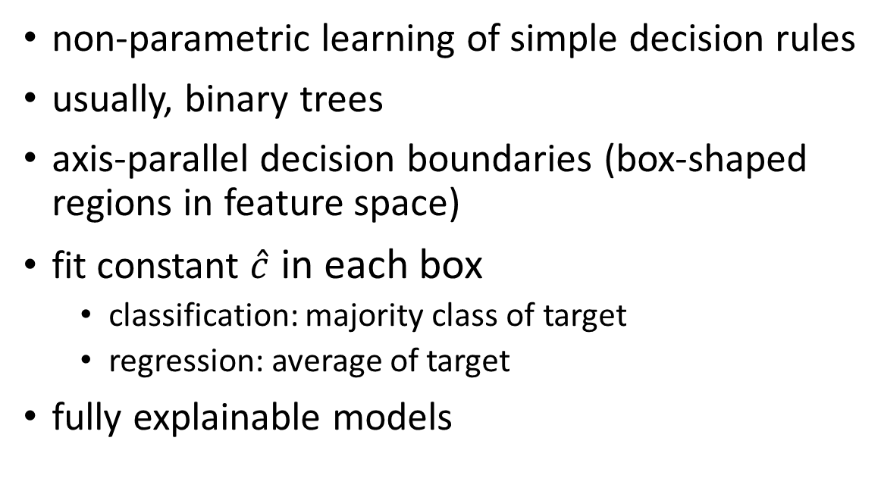
Decision Trees
from Hastie
non-parametric learning of simple decision rules
usually, binary trees
axis-parallel decision boundaries (box-shaped regions in feature space)
fit constant $\hat{c}$ in each box
classification: majority class of target
regression: average of target
fully explainable models
hyperparameter
scikit-learn

Slide 12
Ensemble Learning
idea: combine several individual models (often of the same type) to form an ensemble model with better predictive performance than each of its constituents
→ learning in several different ways from the training data
the trainings of the individual constituent models are (kind of) independent
outputs of individual models are combined (e.g., averaged)

Slide 13
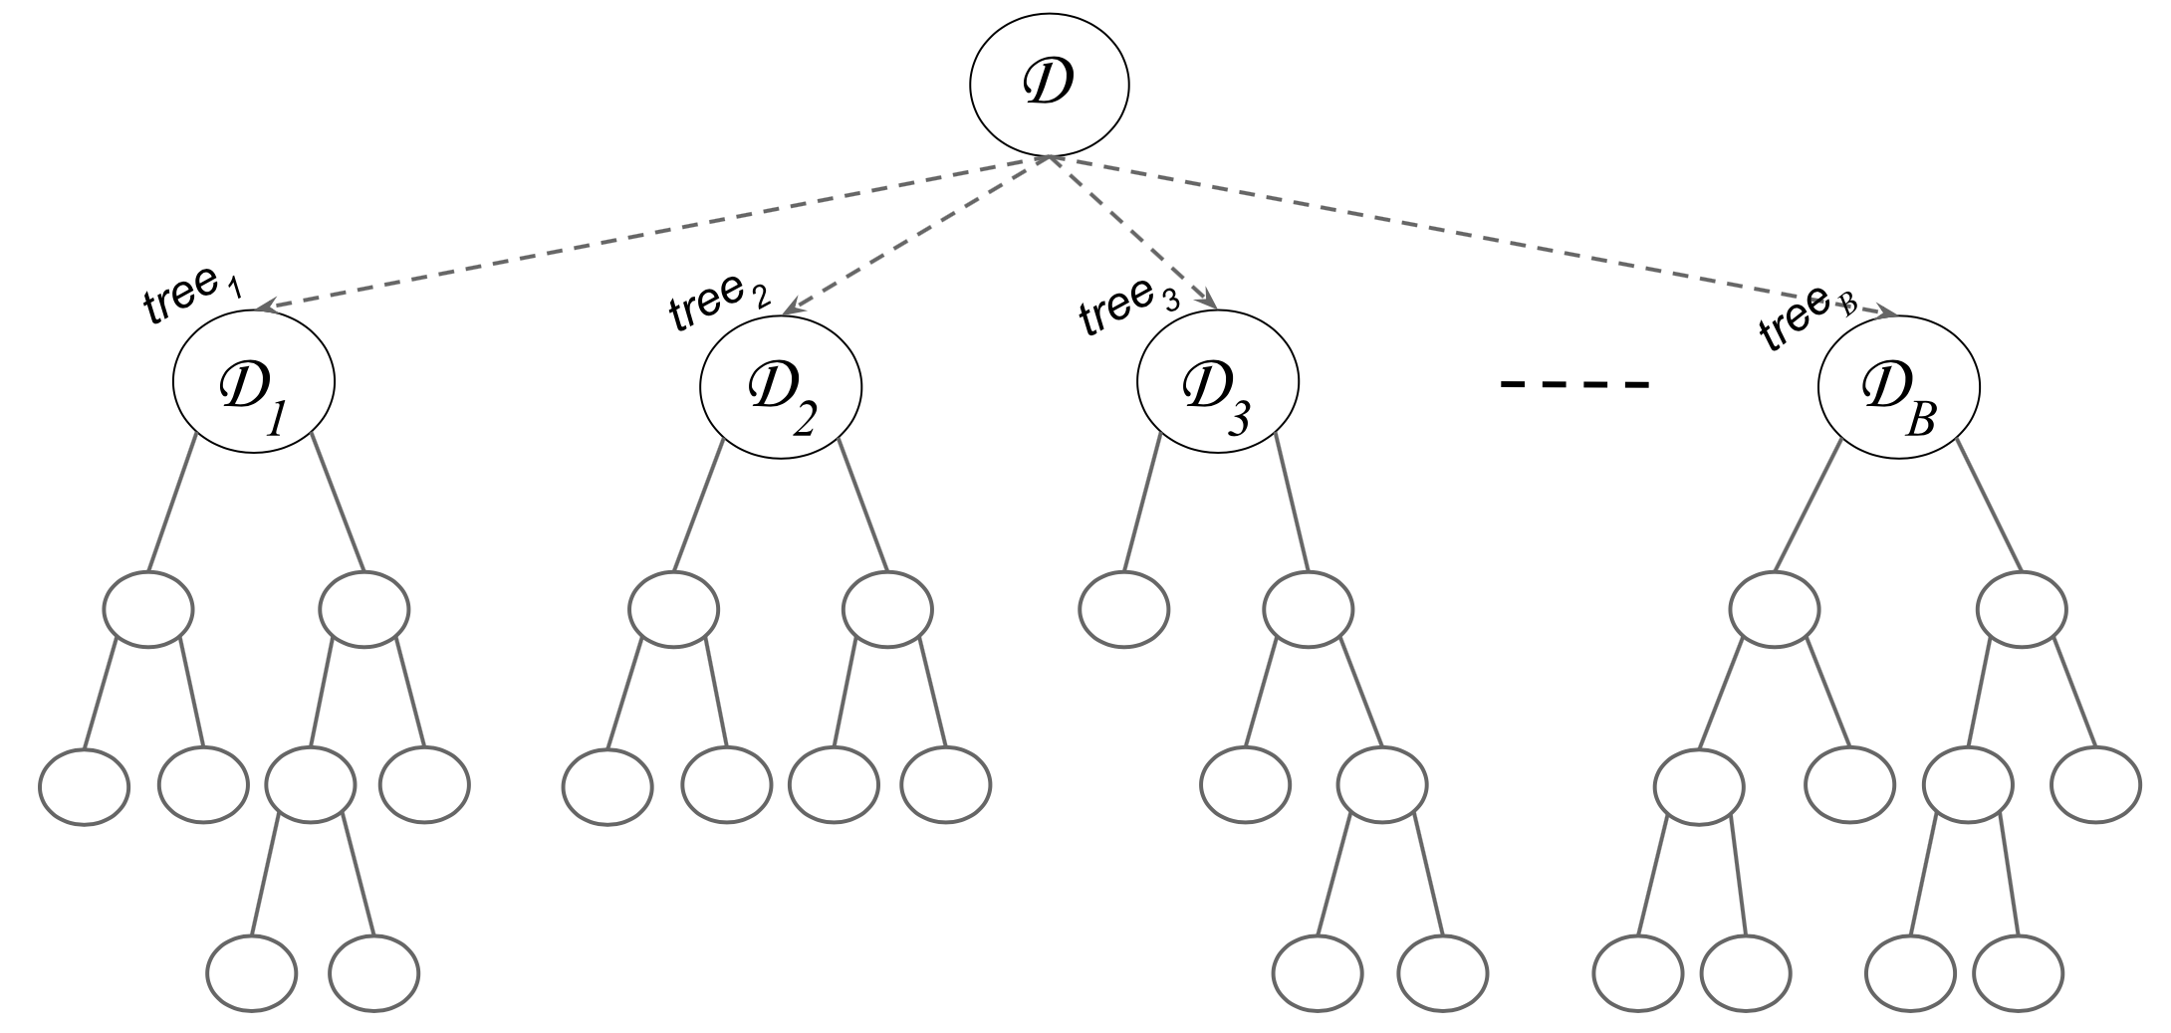
Bagging (Bootstrap Aggregating)
idea: train individual models of ensemble on random subsets of the training data (random sample with replacement)
reduces variance of ensemble model compared to individual models
but not bias → use low-bias base models
individual models combined by averaging (regression) or majority voting (classification) → committee of models
example with decision trees:
source

Slide 14
Random Subspace Method
aka feature bagging
idea: train different members (models) of an ensemble method on random subsets of all features (random sample with replacement)
reduce correlation between ensemble members
individual models combined by averaging (regression) or majority voting (classification) → committee of models

Slide 15
Random Forests
ensemble method using
decision trees as individual models (usually, rather large, low-bias decision trees)
combination of bagging and random subspace method (features sampled at each node in the trees)
compared to individual decision trees, random forests
reduce variance → improve accuracy
lose explainability
one of the most popular off-the-shelf ML algorithms (often, good performance with little hyperparameter tuning and data preparation)

Slide 16
Boosting
idea: sequentially learn and combine several “weak” learners (such as small decision trees, but in principle any ML algorithm) to construct a “strong” one
→ gradually (in a greedy fashion) reducing bias of ensemble model
in simple terms:
building a model from the training data, then creating a second model that attempts to correct the errors from the first model, …
→ each subsequent weak learner is forced to concentrate on the examples that are missed by the previous ones in the sequence
not a committee of models:
typically, use simple, high-bias methods as individual models (e.g., small decision trees)
most prominent: AdaBoost, Gradient Boosting

Slide 17
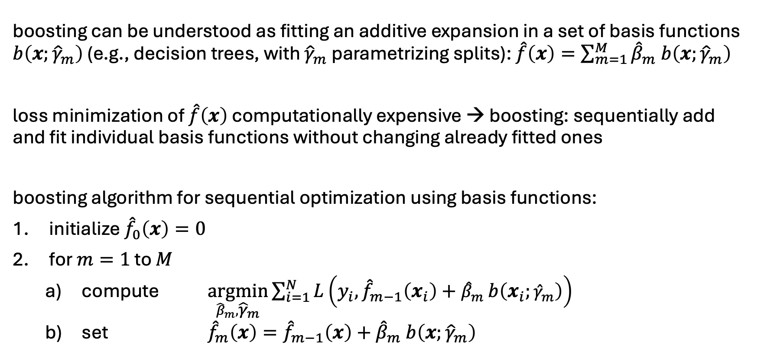
Forward Stagewise Additive Modeling
boosting can be understood as fitting an additive expansion in a set of basis functions $b\left(x;{\hat{γ}}_{m}\right)$ (e.g., decision trees, with ${\hat{γ}}_{m}$ parametrizing splits): $\hat{f}\left(x\right)=\sum_{m=1}^{M}{{\hat{β}}_{m} b\left(x;{\hat{γ}}_{m}\right)}$
loss minimization of $\hat{f}\left(x\right)$ computationally expensive → boosting: sequentially add and fit individual basis functions without changing already fitted ones
boosting algorithm for sequential optimization using basis functions:
initialize ${\hat{f}}_{0}\left(x\right)=0$
for $m=1$ to $M$
compute $\underset{{\hat{β}}_{m},{\hat{γ}}_{m}}{argmin}{\sum_{i=1}^{N}{L\left(y_{i},{\hat{f}}_{m−1}\left(x_{i}\right)+{\hat{β}}_{m} b\left(x_{i};{\hat{γ}}_{m}\right)\right)}}$
set ${\hat{f}}_{m}\left(x\right)={\hat{f}}_{m−1}\left(x\right)+{\hat{β}}_{m} b\left(x;{\hat{γ}}_{m}\right)$

Slide 18
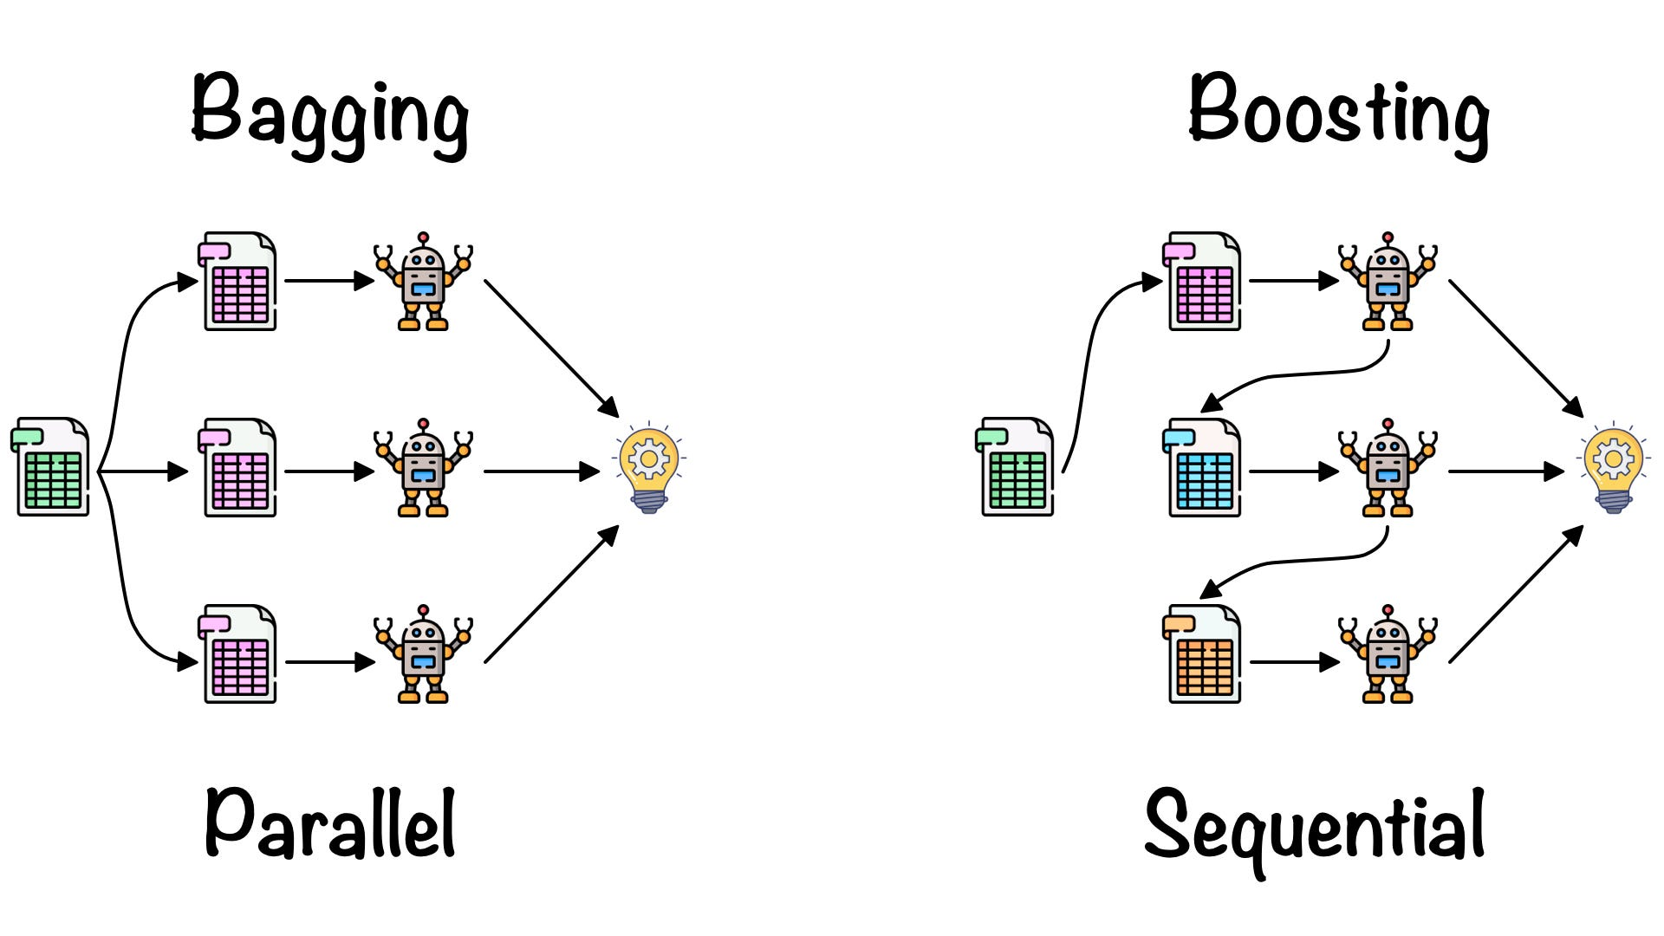

Slide 19
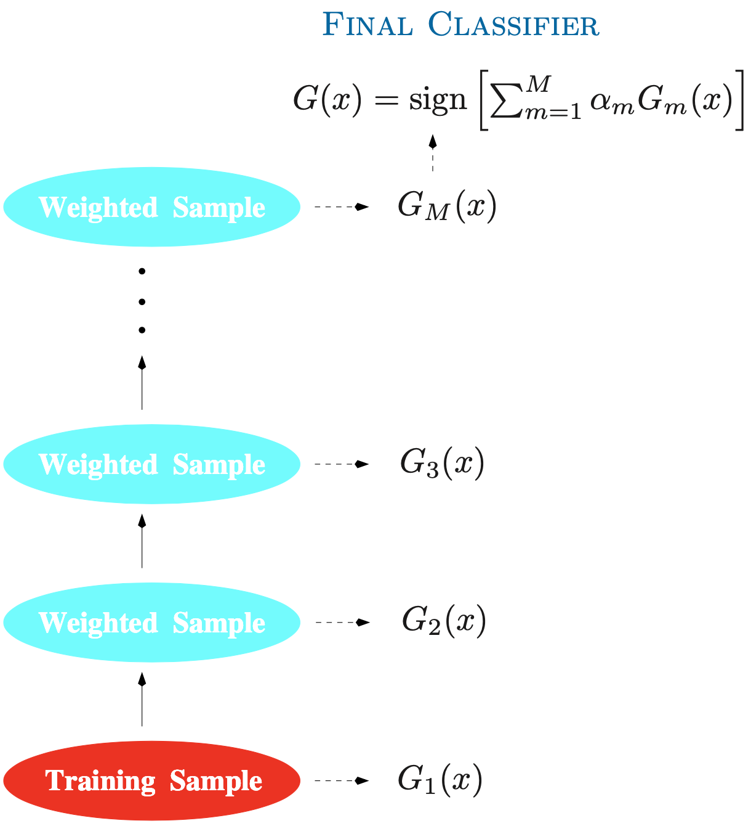

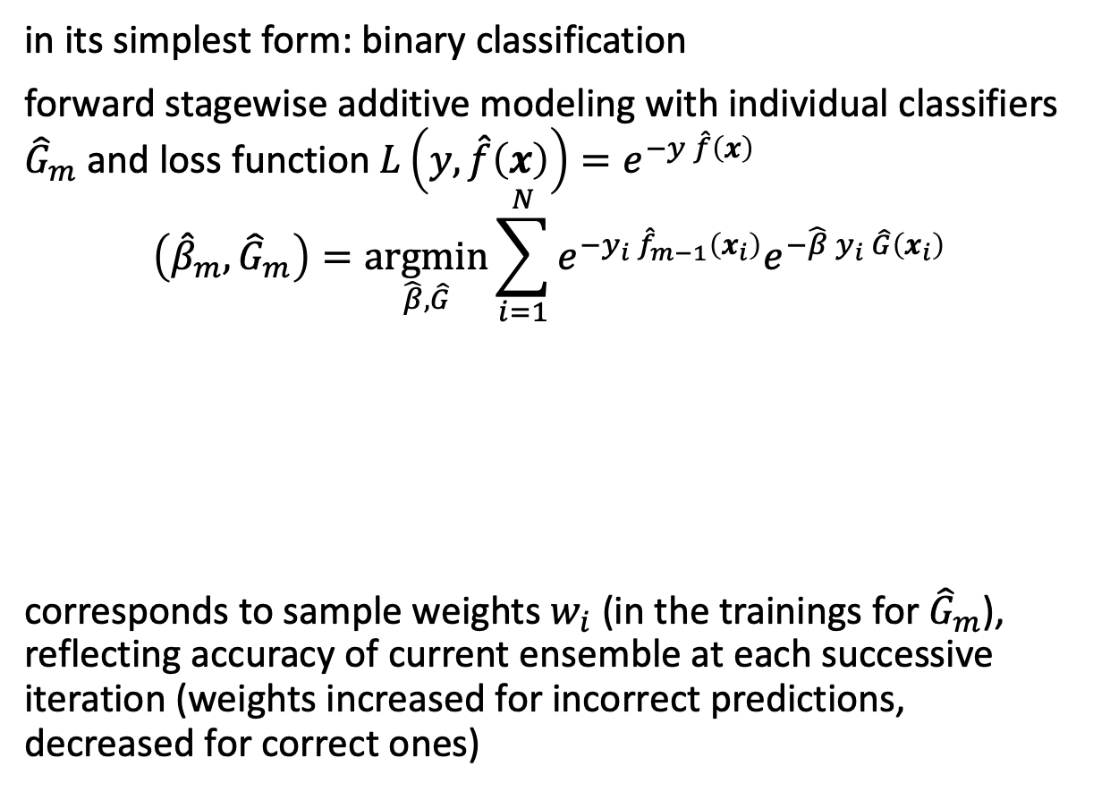
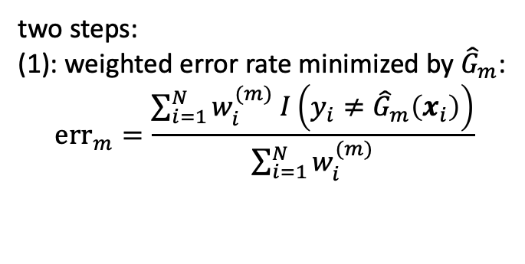

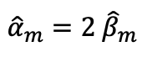
AdaBoost (Adaptive Boosting)
in its simplest form: binary classification
forward stagewise additive modeling with individual classifiers ${\hat{G}}_{m}$ and loss function $L\left(y,\hat{f}\left(x\right)\right)=e^{−y \hat{f}\left(x\right)}$
$$\left({\hat{β}}_{m},{\hat{G}}_{m}\right)=\underset{\hat{β}, \hat{G}}{argmin}{\sum_{i=1}^{N}{e^{−y_{i} {\hat{f}}_{m−1}\left(x_{i}\right)}e^{−\hat{β} y_{i} \hat{G}\left(x_{i}\right)}}}$$
corresponds to sample weights $w_{i}$ (in the trainings for ${\hat{G}}_{m}$), reflecting accuracy of current ensemble at each successive iteration (weights increased for incorrect predictions, decreased for correct ones)
$${\hat{α}}_{m}=2 {\hat{β}}_{m}$$
$$w_{i}\left(\left(x_{i}, y_{i}\right)\right)$$
two steps:
(1): weighted error rate minimized by ${\hat{G}}_{m}$:
$${err}_{m}=\frac{\sum_{i=1}^{N}{w_{i}^{(m)} I\left(y_{i}≠{\hat{G}}_{m}\left(x_{i}\right)\right)}}{\sum_{i=1}^{N}{w_{i}^{(m)}}}$$
→ (2): ${\hat{β}}_{m}=\frac{1}{2}\log{\frac{1−{err}_{m}}{{err}_{m}}}$

Slide 20
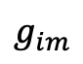
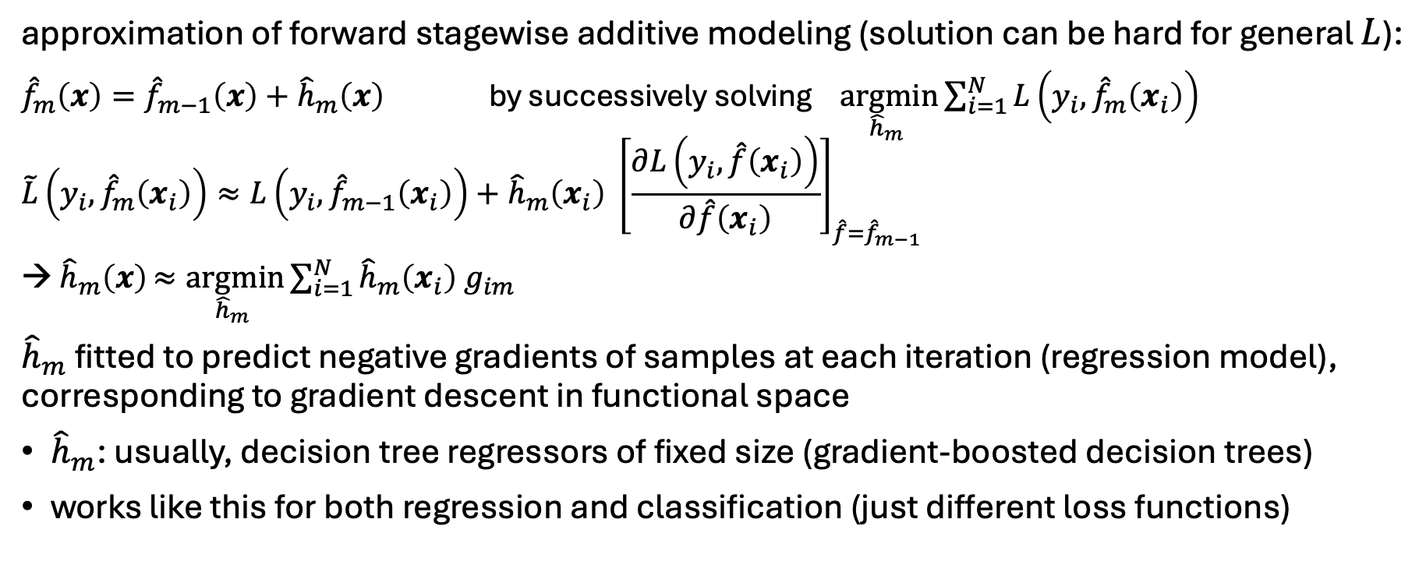
Gradient Boosting
approximation of forward stagewise additive modeling (solution can be hard for general $L$):
${\hat{f}}_{m}\left(x\right)={\hat{f}}_{m−1}\left(x\right)+{\hat{h}}_{m}\left(x\right)$ by successively solving $\underset{{\hat{h}}_{m} }{argmin}{\sum_{i=1}^{N}{L\left(y_{i},{\hat{f}}_{m}\left(x_{i}\right)\right)}}$
$$\tilde{L}\left(y_{i},{\hat{f}}_{m}\left(x_{i}\right)\right)≈L\left(y_{i},{\hat{f}}_{m−1}\left(x_{i}\right)\right)+{\hat{h}}_{m}\left(x_{i}\right) {\left[\frac{∂L\left(y_{i}, \hat{f}\left(x_{i}\right)\right)}{∂\hat{f}\left(x_{i}\right)}\right]}_{\hat{f}={\hat{f}}_{m−1}}$$
→ ${\hat{h}}_{m}\left(x\right)≈\underset{{\hat{h}}_{m} }{argmin}{\sum_{i=1}^{N}{{\hat{h}}_{m}\left(x_{i}\right) g_{im}}}$
${\hat{h}}_{m}$ fitted to predict negative gradients of samples at each iteration (regression model), corresponding to gradient descent in functional space
${\hat{h}}_{m}$: usually, decision tree regressors of fixed size (gradient-boosted decision trees)
works like this for both regression and classification (just different loss functions)
$$g_{im}$$

Slide 21
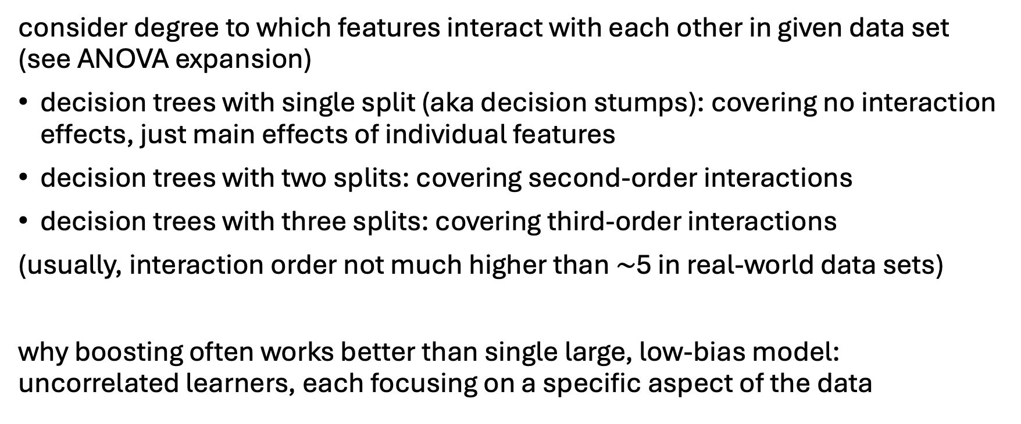
Decision Tree Sizes for Boosting
consider degree to which features interact with each other in given data set (see ANOVA expansion)
decision trees with single split (aka decision stumps): covering no interaction effects, just main effects of individual features
decision trees with two splits: covering second-order interactions
decision trees with three splits: covering third-order interactions
(usually, interaction order not much higher than $\sim$5 in real-world data sets)
why boosting often works better than single large, low-bias model: uncorrelated learners, each focusing on a specific aspect of the data

